Slide 2
Computer software (computer programs)
Computer software (software) are the set of digital instructions that control the actions of a computer.
The preparation of such instructions is called programming/coding, and is done by programmers.

Slide 3
Computer software classification
Computer software is broadly categorized according to:
Functional (purpose); this includes,
i)System software, and
ii)Application software,
Mode of acquisition; this includes:
i)off-shelf(standard) software,
ii)custom made (user developed/in-house) software. Iii)Freeware,
iv)Open source,

Slide 4
v)Shareware and
iv)Public Domain software.

Slide 5
Software
System software
Operating system
Firmware
Application software
Utilities
Device drivers
Programming languages

Slide 6
System software
The System software are programmes that start up a computer and manage the general functioning of the system devices.
The types of system software include
Firmware,
Operating system,
Utilities/Utility programs
Programming languages, ,
Device drivers.

Slide 7
Firmware (stored logic)
Firmware are the small programs recorded by the computer manufacturers at the factory on electronic chips mounted on the computer’s motherboard or any other device to control the devices .

Slide 8
Some of the devices containing firmware are remote controls, calculators, cell phones, digital cameras, and computer ROM chips.

Slide 9
Device drivers
A device driver is a program that controls a particular type of device that is attached to a computer by converting the more general input/output instructions of the operating system to messages that the device type can understand.
The hardware devices require device drivers so that the operating system can recognise the device to be able to communicate effectively with them.

Slide 10
The drivers are usually written by the device manufacturers. These programs can be updated time and again to improve the performance of the devices.

Slide 11
The Operating system (OS) software
The Operating system software is a set of instructions that govern the working (operation) of a computer system by serving as a bridge between the computer hardware and the application software with which the computer user works.
Examples of operating systems include:
Windows 7, Windows XP, Windows Vista, Windows 2000, Window 95, Windows 98, Mac OS, UNIX and DOS.

Slide 12
General functions of the operating system
The OS provides an interface between the user and the computer.
It manages the computer processor by managing the flow of information in the computer.
It manages the computer hardware and software by directing information to the appropriate destinations. For example if you send anything for printing it is the duty of the Operating System to direct that information to the right device.

Slide 13
It does File management ; this includes keeping record of the saved files, their names, sizes, location etc.
The OS manages the shutting down of the computer.
It controls the running of other programs, i.e. loads and enables the other programs to operate.

Slide 14
It does Memory management. This involves organising the use of the computer’s main memory into locations (blocks) where it constantly assigns memory locations to the data and program instructions.

Slide 15
It does Error handling. error handling involves the ability to identify errors that come about in the use of the computer system by the user, and in the execution of instructions.
The operating system completes the booting process of the computer system, by checking the reliability of the system, and loads drivers for installed devices such as mouth and CD-ROM.
It does Spooling of print jobs. The operating system places a task (print job) into a queue for extended or later processing.

Slide 16
SPOOL (simultaneous peripheral operations on-line) It is a type of buffering The most common spooling application is print spooling.

Slide 17
Types of operating system
Operating systems are categorized based on:
The types of computers they control and the sort of applications they support.
According to the number of users that can be logged in at a time.
The number of tasks an operating system can perform concurrently.
The human computer interface (HCI) used.

Slide 18
Classification according to tasks handled
Single operating system
Multitasking operating system
Multithreading operating system
Multiprocessing operating system

Slide 19
Single task operating system
The single task or single program operating system are OS that allow processing of only one user program at a time. This implies that the user can only run one interactive program at a time.
An example of such an operating system is MS-DOS.

Slide 20
Multitasking operating system
A multitasking operating system is one capable of allowing multiple software processes to run at the same time on one computer (CPU).

Slide 21
Multithreading operating systems
A multithreading operating system is one that allows different parts of a software program to run concurrently.
Multithreading is the ability of a program or an operating system to manage its use by more than one user at a time and to manage multiple requests by the same user without having to have multiple copies of the program running on the computer.
Each user request for a program or system service is kept track of as a thread with a separate identity.

Slide 22
Operating systems that would fall into this category are Linux and UNIX.

Slide 23
Multiprocessing operating system
A Multiprocessing operating system is one capable of supporting and using more than one computer processor at a time.
multiprocessing is the coordinated processing of programs by more than one computer processor. Multiprocessing operating systems enable several programs to run concurrently.

Slide 24
Classification according to the number of users
Single user operating system
Multiuser operating system

Slide 25
Single-user operating system
A single-user operating system is designed to manage the computer so that a single user can effectively do one task at a time.
The Palm OS for Palm handheld computers is a good example of a modern single-user, single-task operating system.

Slide 26
Multi-user operating system
A multi-user operating system is one that allows for multiple users to use the same computer at the same time. UNIX, VMS and mainframe operating systems, such as MVS, are examples of multi-user operating systems.

Slide 27
Classification of OS according to human–computer interface
The user interface is the aggregate of means by which the user interacts with the computer system. A user interface provides:
Input, allowing the users to manipulate a system
Output, allowing the system to indicate the effects of the users' manipulation

Slide 28
Graphical user interface (GUI) operating systems
A graphical user interface (GUI) is a type of user interface that allows users to interact with programs by manipulating graphics, along with a keyboard and pointing devices such as a mouse, to provide an easy-to-use interface to a program.

Slide 29
A GUI provides windows, pull-down menus, scrollbars, icon images, wizards, list boxes, radio buttons, and check boxes to enable users to interact with the operating system or application. The actions are performed through direct manipulation of the graphical elements.

Slide 30
The acronym WIMP is used to refer to Windows, Icons, Menus and Pointing device in respect to GUI.
The GUI operating systems familiar to most people today are Microsoft Windows, Mac OS X, and X Window System interfaces

Slide 31
Wizards
A wizard is a tool to guide you through the steps of a process or task by asking a series of questions or presenting options for you to proceed through a task.

Slide 32
Icons
An icon in computing is a small pictogram that conveys its meaning through its pictorial resemblance to a physical object. Icons may represent a file, folder, application or device on a computer system.
Placing the cursor on the icon, and clicking (or double-clicking) a mouse, trackball or other button starts the function or program.

Slide 33
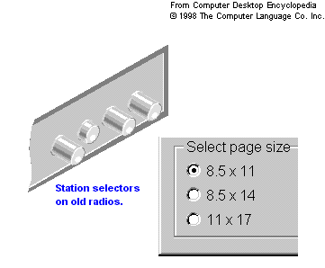
Radio buttons
Radio buttons are small, hollow circles adjacent to text in a configuration menu box. They are arranged in groups of two or more. Clicking on the radio button or on the caption, or using a keyboard shortcut, places a solid dot in the circle, selecting the option. As one radio button is selected, others within the category switch off, so that only one choice can be selected in each category.

Slide 34
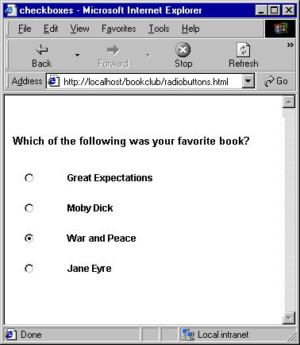
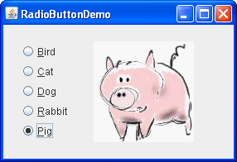

Slide 35
A radio button allows the user to choose only one of a predefined set of options. For example, a set of radio buttons may have options like ‘Yes’, ‘No’, and ‘Not sure’ so that users can simply click on the radio button corresponding their choice.

Slide 36
Check boxes
In computing, a check box (or tick box) is a graphical user interface element (widget) that permits the user to make multiple(several) selections from a number of options at the same time.

Slide 37
Check boxes are usually shown on the screen as square boxes that can contain white space (for false) or a tick mark or X (for true) if selected.
A caption describing the meaning of the check box is normally shown beside the check box.
Reverting the state of a check box is done by clicking the mouse on the box, or the caption, or by using a keyboard shortcut.

Slide 38
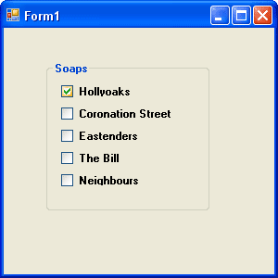
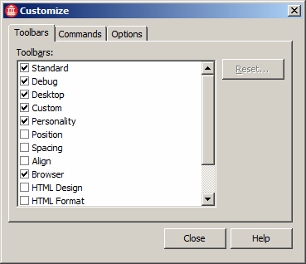

Slide 39
Menu Bar
A menu bar is a region on a screen of a computer program window which contains lists of available menus or application interface where drop down menus or a lists of available menus for a certain program are displayed.

Slide 40
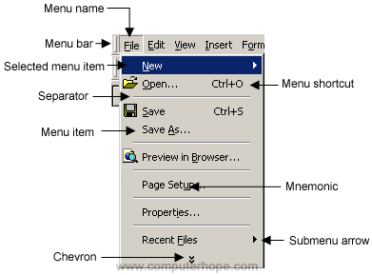

Slide 41
Drop-down menus
A drop-down menu, also called a pull-down menu, is a menu of commands or options that appears when you select an item with a mouse or click on the drop-down arrow at the right-hand corner of the menu box.

Slide 42
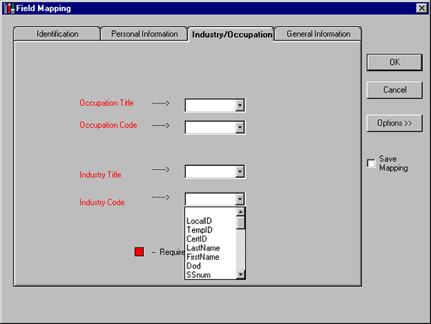
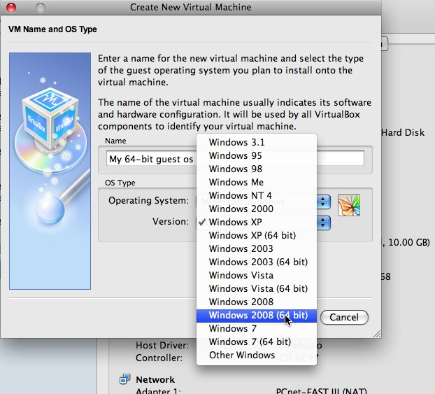

Slide 43
List boxes
A list box is an on-screen display of text items in a scrollable window. The list box allows the user to select one or more items from a list contained within a static, multiple-line text box. The user clicks inside the box on an item to select it, sometimes in combination with the Shift key or Control key in order to make multiple selections.

Slide 44
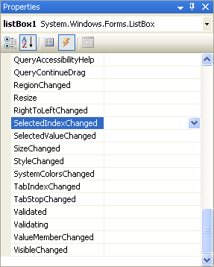
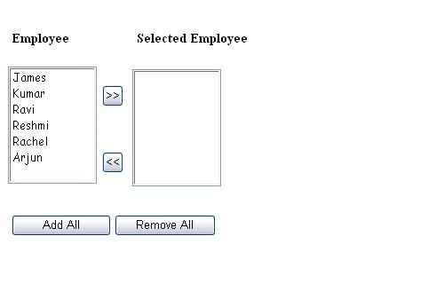

Slide 45
Text boxes
A text box, text field or text entry box allows the user to input text information to be used by the program.

Slide 46
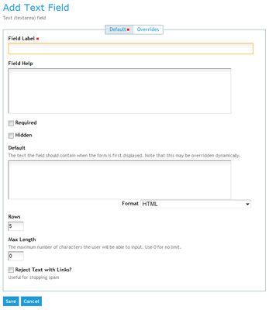
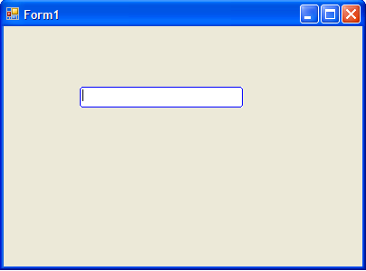

Slide 47
Scrollbars
A scrollbar is a graphical object in a graphical user interface (GUI) with which continuous text, pictures or anything else can be scrolled, i.e., viewed even if it does not fit into the space in a computer display, window, or viewport. In some video applications, the time can be adjusted with a scrollbar.

Slide 48
Toolbars
A toolbar is a series of selectable icon buttons in a GUI that gives the user an easy way to select desktop, application or Web browser functions. Toolbars are typically displayed as either a horizontal row or a vertical column around the edges of the GUI where they are visible while the application is in use.

Slide 49
Toolbars are used to activate functions in the application.
Many toolbars are customizable, letting you add and delete buttons as required.
Toolbars may be fixed in position or may float, which means they can be dragged to a more convenient location in the application window by the user.

Slide 50
Status bar
A status bar is an information area typically found at the bottom of windows in a graphical user interface. A status bar is sometimes divided into sections, each of which shows different information.
Its job is to display information about the current state of its window, although some status bars have extra functionality, for example, web browsers’ status bars have clickable sections that pop up a display of security or privacy information.

Slide 51
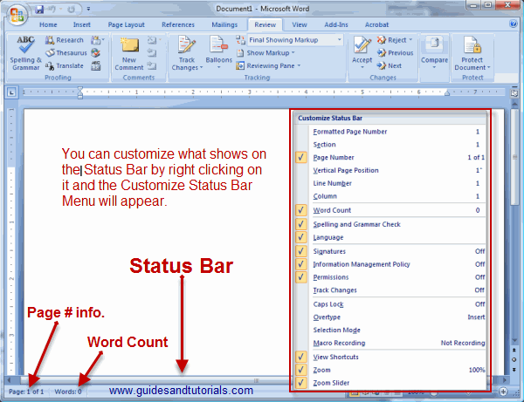

Slide 52
Advantages of a GUI operating System
make computer operation more intuitive, and thus easier to learn and use.
GUIs generally provide users with immediate, visual feedback about the effect of each action. For example, when a user deletes an icon representing a file, the icon immediately disappears, confirming that the file has been deleted (or at least sent to the trash can)

Slide 53
GUIs allow users to take full advantage of the powerful multitasking capabilities of modern operating systems by allowing such multiple programs and/or instances to be displayed simultaneously.
GUIs have windows that enable a user easily to view, control, and manipulate multiple things at once.

Slide 54
GUI is easy to use because of the use of graphics because user simply uses the mouse to choose the appropriate icons/commands.
GUI enables a user to create shortcuts, tasks, or other similar actions to complete a task or run a program

Slide 55
Disadvantages of GUI
GUI require a lot of system resources (e.g. memory space) because of each of the elements that need to be loaded such as icons, fonts, etc.
when it is not properly built, it can be very difficult to work with.
it might require the installation of additional software, e.g., the "runtime environment" in the case of java.

Slide 56
It might be slower to download into memory.
The user choices are restricted to those on the menus

Slide 57
Command-line user interface (CLI) OS
The command line is a user interface (CLI)that is navigated by typing commands at a command prompt; for example, the root MS-DOS command line prompt generally is C:\>.
CLI can only be navigated by using a keyboard and entering commands; it does not use a mouse.
This method of instructing a computer to perform a given task is referred to as ‘entering’ a command: the system waits for the user to conclude the submitting of the text command by pressing the Enter key on the keyboard.

Slide 58
A command-line interpreter (shell) then receives, analyses, and executes the requested command. Upon completion, the command usually returns output to the user in the form of text lines on the CLI. This output may be an answer if the command was a question, or otherwise a summary of the operation.

Slide 59
CLIs are often used by programmers and system administrators, in engineering and scientific environments, and by technically advanced personal computer users. CLIs are also popular with visually disabled people, since the commands and feedbacks can be displayed using Refreshable Braille displays.

Slide 60
Advantages of CLI
It does not require a lot of memory resources to run because it is light.
Users have much more control of their file system and operating system in a command line interface. For example, users can easily copy a specific file from one location to another with a one-line command.
It is precise because the user states exactly what he or she wants to do, and the more sophisticated CLIs keep a record of the commands that have been issued.

Slide 61
Disadvantages of CLI
Difficult to use by new users because of the memorization and familiarity of commands needed to operate a command line interface new users find it much more difficult to successfully navigate and operate a command line interface.
CLIs cannot show images.

Slide 62
It is fast and precise because command line users only need to use their keyboards to navigate a command line interface and often only need to execute a few lines to perform a task.

Slide 63
CLI | GUI
The user has to know the commands or look them up | The commands are much more intuitive
The commands usually have to be entered in full | Command shortcuts are possible such as <Ctrl> C to copy
The user has to learn the commands and more training is needed | Less learning and training by the user is required
The interface can be daunting, more difficult to use and the user is more likely to make mistakes | The GUI is more user-friendly
There are no graphics | Graphics are used to represent tasks, files etc.
There are no menus | Menus are used for making choices and selections
The user has complete control | The user choices are restricted to those on the menus
Commands have to be entered accurately with the correct spellings and syntax (rules) | Spelling and typing errors are avoided
No pointing device is used | A pointing device is used to select items and make choices

Slide 64
Touch user interface
Touch user interface are graphical user interfaces using a touchscreen display as a combined input and output device. Used in many types of point of sale, industrial processes and machines, self-service machines etc

Slide 65
Voice user interfaces
Voice user interfaces accept input and provide output by generating voice prompts. The user input is made by pressing keys or buttons, or responding verbally to the interface.

Slide 66
Operating System Classification according to processing mode
Processing mode refers to the method of processing that the operating system supports.
These are:
Time sharing operating system
Batch process operating system
Real-time processing operating system
Embedded operating systems

Slide 67
Time sharing operating system
Time sharing operating system is one method where multiple users with different programs interact at the same time on a multi-access system.
The UNIX operating system is used for multi-access time sharing systems, for example in universities, where many students and professors may be connected to the central CPU at one time from different terminals.

Slide 68
Batch process operating system
A batch process operating system is one where programs and data are collected together in a batch queue before processing starts.
Each piece of work the computer will do is called a job, consisting of a program to be run and data that will be manipulated by it.
Batch jobs can be stored up during working hours and then executed whenever the computer is least in use (usually at night). Once a batch job starts, it continues until it is done or until an error occurs.

Slide 69
There is no interaction with the user while the program is being run. Batch processing can be used for fairly automatic tasks; for example, weekly or monthly payroll processing, processing utility bills (water, electricity, etc.) and credit card bills.

Slide 70
Real-time processing operating system
Real time operating systems are designed to respond to an event within a predetermined time. As soon as the data is input, it is processed and output immediately.
These types of operating systems are found in environments where computers are responsible for controlling systems continuously; for example, robotics, manufacturing, interactive games, airlines and theatre booking systems.

Slide 71
Distributed operating systems
A distributed operating system manages a group of distributed computers. Distributed computations are carried out on computer networks that work in cooperation.

Slide 73
Embedded operating systems
The operating systems designed for use in embedded computer systems are known as embedded operating systems. They are designed to operate on small machines like PDAs. They are able to operate with a limited number of resources.

Slide 74

File management
Any document is stored as a file by the computer.
Each file has a file name
Each file name has two parts: filename.extension
By default the computer allocates a name to a file which you can change.

Slide 75
File extensions
A file extension is the end part of a file name that is separated by a dot, containing characters based on the program used to create the file
The extension helps to identify the file type.
It identifies what program to associate the file with and how to properly open it using the correct program.
it helps to easily locate files.

Slide 76
Some Common file extensions
.EXE EXEcutable commands
.SYS Various types of SYStem files – usually drivers to control devices
.DOC or .DOCX DOCument files created by e.g. Microsoft Word
.AVI Microsoft Windows Movie file
.BMP Graphical Bit Mapped File used in Windows Paint.
.DOCX New Microsoft Word open standard introduced with Microsoft Word
2007
.HTML Web page files containing HTML or other information found on the
Internet
.GIF Graphics Interchange Format, a digital image file format
.TXT TeXT files associated with the Notepad program
.XLS A spreadsheet file created by Microsoft Excel
.JPG or
.JPEG A graphics file commonly used for photos and illustrations
.PDF Portable Document Format – a file type that displays finished text
and graphics in application such as Adobe Acrobat.

Slide 77

File hierarchy
A file hierarchy defines directories (also called folders), which can contain files and other directories.
The top-most directory in any file system is called the root directory.
A directory that is below another directory is called a subdirectory.
A directory above a subdirectory is called the parent directory.

Slide 78

File path
C:\My Documents\assignments\English\nouns.doc
Root directory: C:\
Directory(folder): \My Documents\
Subdirectory(subfolder): \English\
file: \nouns.doc

Slide 79
To view file extensions in Windows XP or later versions:
Click on Start.
Click Control Panel.
Click Folder Options.
Click View.
Uncheck Hide extensions for known file types.

Slide 80
To view hidden files in Microsoft Windows:
Open Windows Explorer.
Click the Tools drop down menu. If you don’t see the Tools option, try pressing Alt.
Click either Folder Options or Options.
Click the View tab.
Within the View tab, select the option Show hidden files and folders.

Slide 81
Factors to consider when choosing an operating system
The Human–computer interface
The Applications intended for the computer.
The Cost of the operating system.
Its availability on the market.
Reliability of the operating system.
The basic design of the computer.
the Hardware provisions of the computer.

Slide 82
Installation and configuration of the operating system
There are many reasons why you might need to install or reinstall an operating system:
i)When you need to upgrade to a more advanced operating system.
ii) When the existing operating system files have been corrupted and it therefore no longer functions.
iii) When you need to set up a brand new machine which was supplied without an operating system.

Slide 83
iv) When you need to perform a recovery on your computer after it has suffered a fatal error, when it is best to start with a clean, freshly formatted hard drive.

Slide 84
v) In case of an irreparable Registry or System file corruption in the existing Windows installation.
Note: Before doing a clean install of an operating system, you will need to back up your data files.

Slide 85
Utilities (Utility Programmes)
Utility programs are system software programs which provide useful services, such as performing common tasks and ‘housekeeping’ routines.
They are designed to configure, analyse, optimise, and maintain a computer in a normal working state. Some are included with the operating system (for example, disk repairing programs) while others are purchased separately by the user (for example, Norton Disk Doctor).

Slide 86
Examples of utility programs and their use:
Backup: This utility allows you to make a duplicate copy of every file on your hard disk, which can be stored on CDs or diskettes.
Disk defragmentation: A defragmenter utility finds fragmented files on a disk and organises them back in a contiguous manner.

Slide 87
Disk repair utility: A disk repair utility scans a hard disk or floppy disk for bad sectors (defective areas) and either makes repairs to these sectors, or marks the defective area so that the operating system does not store any data in that location.

Slide 88
Virus protection utility: Antivirus software programs scan for computer viruses and removes them.
Computer language translators: Computer language translators (assemblers, compilers and interpreters) translate a program written by a programmer into machine language (the language the computer can understand).

Slide 89
Check Disk utilities: Check Disk is a utility that checks your hard drive (or floppy drive) for problems. It will check for directory structure errors, file errors, etc.
Scandisk: This is a utility provided with Windows that is used to scan computer disks to see if there are any potential problems on the disk, such as bad disk areas, and possibly repairs them. Since disks are magnetic media, all disks, including the hard drive, can be corrupted.

Slide 90
Disk cleaners
These are utilities used to find files that are unnecessary to the computer’s operation and taking up disk space. Disk cleaners help the user to decide what to delete when your hard disk is full.
Disk partitioning software
Such utilities are used to divide an individual drive into multiple logical drives, each with its own file system, which can be mounted by the operating system and treated as individual/separate drives.

Slide 91
Disk compression utilities
Disk compression utilities are used to compress the contents of a disk, increasing the capacity of the disk, or to decompress its compressed contents.
File managers: A file manager or file browser is a computer utility program that provides a user interface to work with file systems. The most common file management operations used include create, open, edit, view, print, play, rename, move, copy, delete, attributes, properties, search/find, and permissions.

Slide 92
System profilers
System profilers provide detailed information about the software installed and hardware attached to the computer.
Data compression and decompression utilities
Data compression utilities output a shorter stream or a smaller file when provided with a stream or file intended to limit the disk space used or transmission bandwidth.
The compressed file must be decompressed in order to use it.

Slide 93
Cryptographic utilities
Cryptographic utilities are used to encrypt and decrypt streams and files.
Cryptography is the art of hiding information by transforming it (encrypting it) into an unreadable format, called cipher text. Only those who possess a secret key can interpret (decrypt) the message into plain text.

Slide 94
Registry cleaners
Registry cleaners clean and optimize the Windows registry by removing old registry keys that are no longer in use.

Slide 95
Network utilities
Network utilities are tools that analyse the computer’s network connectivity, configure network settings, check data transfer or log events.

Slide 96
Screensavers
A screensaver (or screen saver) is a computer program that blanks the screen or fills it with moving images or patterns when the computer is not in use.

Slide 97
The screensaver file can be programmed in several different ways to run whenever the computer is left on but idle for a certain period of time

Slide 98
Uses of a screen saver
to prevent phosphor burn-in on CRT and plasma computer monitors (hence the name)
screensavers are used primarily for entertainment
Used for security of the system
Used to display system status information.

Slide 99
Programming Languages
A programming language is a set of instructions used to build, design other computer programs.
A programming language has a unique set of keywords (words that it understands) and a special syntax for expressing and organising program instructions.
Syntax refers to the spelling and grammar of a programming language.

Slide 100
Levels of programming languages
The machine language. This is the lowest possible level of language in which it is possible to write a computer program. All other languages are said to be high-level or low-level according to how closely they can be said to resemble machine code.
High level programming languages. These are Programming languages that enable programmers to write programs that are more or less independent of a particular type of computer are considered high-level because they are closer to human languages and further from machine languages.

Slide 101
Low-level programming languages
Low-level programming languages are machine oriented (or machine dependent). Thus each language is unique to the CPU on which it is implemented and is, therefore, not usable on a computer with a different CPU.
Low-level languages have the advantage that they can be written to take advantage of any peculiarities in the architecture of the central processing unit (CPU) which is the ‘brain’ of any computer.

Slide 102
Writing a low level language is time consuming.
It is easy to make mistakes.

Slide 103
There are two categories of low-level programming languages: Machine Language and Assembly Language.

Slide 104
Machine language – First Generation Language (1GL)
Machine language is the lowest possible level in which you can program a computer because It is in the machine’s own native machine code, consisting of strings of ones and zeroes and stored as binary numbers.
The main problems with using machine code directly are that it is very easy to make a mistake, and very hard to find it once you realise the mistake has been made.

Slide 105
Characteristics of 1GL
Fastest to execute because it is already in the language that the computer can understand
Difficult to decipher (requires the aid of a reference manual to decipher the meaning of each code)
Easy to make mistakes in the sequence of 1s and 0s; replacing a 1 for a 0 can result in the wrong command/instruction being executed
Time-consuming and tedious to write
Machine dependent

Slide 106
Programing becomes more difficult as the complexity of the program increases

Slide 107
Assembly language – Second Generation Language (2GL)
Assembly language is written using mnemonic codes (abbreviated English words, i.e. short codes) that suggest their meaning and are therefore easier to remember. These codes represent operations, addresses that relate to main memory, and storage registers of the computer.
Assembly language, being machine dependent, is faster and more efficient in the use of hardware than high-level programming languages.

Slide 108
Assembly languages are translated into machine language by language translators known as assemblers.

Slide 109
Characteristics of 2GL
Easier to write than machine language
As with machine language, assembly language is machine dependent

Slide 110
High-level programming languages
A high level programming language is that which enables a programmer to write programs that are more or less independent of a particular type of computer, Such languages are considered high-level because they are closer to human languages and further from machine languages.

Slide 111
High level languages use abstraction which is the process by which data and programs are defined with a representation similar in form to its meaning (semantics), while hiding away the implementation details.

Slide 112
Examples of high level languages include: Ada, Algol, BASIC, COBOL, C, C++, FORTRAN, LISP, Pascal, and Prolog.
Programs written in a high-level language must be translated into machine language by a compiler or interpreter.
i.e. There are two ways to run programs written in a high-level language. The most common is to compile the program; the other method is to pass the program through an interpreter.

Slide 113
Compiler
A compiler is a program that translates a source code into object code. The compiler derives its name from the way it works, looking at the entire piece of source code and collecting and reorganizing the instructions (compiling or putting together).
A source code is the Program instructions in their original form, as written (coded) by the programmer in a particular programming language.

Slide 114
The object code is the code produced by a compiler from a source code.
To get from source code to machine language, the programs must be transformed by a compiler. The compiler produces an intermediary form called object code. Object code is often the same as or similar to a computer's machine language.

Slide 115
Interpreters
An interpreter is a program that executes instructions written in a high-level language.
An interpreter translates high-level instructions into an intermediate form, which it then executes. In contrast, a compiler translates high-level instructions directly into machine language.

Slide 116
Comparing Compilers and Interpreters
Compiled programs generally run faster than interpreted programs. The advantage of an interpreter, however, is that it does not need to go through the time consuming compilation stage during which machine instructions are generated. The interpreter, on the other hand, can immediately execute high-level programs.
Both interpreters and compilers are available for most high-level languages.

Slide 117
Characteristics of high-level languages
They are machine independent hence portable
They are user friendly and easy to learn
High-level language programs are easy to debug
They are more flexible hence they enhance the creativity of the programmer, increasing productivity
They are executed much slower than low-level programming languages
They have to be translated into machine code before execution

Slide 118
One instruction translates into several machine code instructions

Slide 119
High-level programming languages are problem oriented, therefore they enable the programmer concentrate on solving the problem.
Since high-level languages reflect the logic and procedures used in a human algorithm, the programmer is able to concentrate on developing task algorithms rather than on how the computer will carry out the instructions. The words and grammar of high-level languages are English-like and this makes the programs more readable and easy to write.

Slide 120
A high-level language is governed by a strict syntax (set of grammatical rules). Since the syntaxes of high-level languages are standardised, the languages are portable (they can be used on different computer systems). Thus high-level languages are machine independent.
high-level languages are easier to read, write, and maintain than low level language. They also permit faster development of large programs.

Slide 121
programs written in a high-level language must be translated into machine language by a compiler or interpreter.

Slide 122
Advantages of High level languages
High level language is easily understood by programmers because it is closer to human language.
High-level programming languages are problem oriented, therefore they enable the programmer concentrate on solving the problem.
Since high-level languages reflect the logic and procedures used in a human algorithm, the programmer is able to concentrate on developing task algorithms.

Slide 123
The words and grammar of high-level languages are English-like and this makes the programs more readable and easy to write.

Slide 124
A high-level languages are machine independent Since the syntaxes of high-level languages are standardized so that they can be used on different computer systems.
they are easier to read, write, and maintain.
They also permit faster development of large programs.

Slide 125
High-level languages have evolved over the years and can be grouped into five categories:
Third Generation Languages (3GL),
Fourth Generation Languages (4GL),
Object Oriented Programming Languages (OOP),
Fifth Generation Languages (5GL) and
Scripting Languages.

Slide 126
Third Generation Languages (3GL)
Third generation language(3GL) is a high level language designed to be easier for a human to understand, including things like named variables.
English words are used to denote variables, programming structures and commands, and Structured Programming is supported by most 3GLs. Commonly known 3GLs are FORTRAN, BASIC, Pascal and the C-family (C, C+, C++, C#, Objective-C) of languages.

Slide 127
Characteristics of 3GL
It uses English words and symbols, and is therefore even easier to write
It is machine independent

Slide 128
Application software
Application software is software that allows end users to accomplish one or more specific tasks.

Slide 129
Typical application software include industrial automation software, business software, video games software packages, quantum chemistry and solid state physics software, telecommunications software (i.e., the Internet and everything that flows on it), database software, educational software, medical software, military software, molecular modelling software, image editing, spreadsheets, simulation software, word processing, decision-making software, etc.

Slide 130
Category | Application software
Entertainment | Applications for games Example: Solitaire Applications for media, and DVD and CD burners Example: Rhapsody, Pandora, Roxio Toast
Business | Applications for accounting, customer relationship management, database management, spreadsheets, word processing and presentation software
Photo management | Applications for photo organising, photo editing and photo sharing Example: Adobe Photoshop
Collaborative | Applications for blogging, instant messaging and e-mail communication Example: Microsoft Outlook, Windows Live Messenger, AIM
Graphically Oriented | Applications used to design graphics, such as desktop publishing software software
Educational | Content access software has the content and/or features adapted for use by educators and students. For example, it may deliver evaluations (tests), track progress through material, or include collaborative capabilities.
Content access | Used primarily to access content without editing, but may include software that allows for content editing. Such software addresses the needs of individuals and groups to consume digital entertainment and published digital content. (Examples include media players, Web browsers, help browsers, and games.)
Industry | Production and manufacturing, computer numerical control (CNC), computer-aided design (CAD), and computer-aided manufacturing (CAM), building information modelling, computer-aided engineering (CAE), geotechnical engineering, electronic design automation (EDA), electronic circuit simulators, film production, screenwriting, robotics

Slide 131
Application software can also be categorised as follows: general-purpose, specialised, integrated, customized, and custom-written software packages.

Slide 132
General-purpose software
This is software that is not written for any specific business or organisation but which can be used or adapted to suit a wide selection of users’ specific needs. For example, a teacher can use a spreadsheet package to prepare a student end of term grades report, and a word processor to write letters to parents, but the same packages could be used in business to perform different tasks such as accounting or memo writing.

Slide 133
Specialised software
Specialised software is written for a specific task rather than for a broad application area. These programs provide facilities specifically for the purpose for which they were designed. For example, a payroll program will usually only be able to deal with all aspects of a company’s payroll only, it cannot be used for other purposes such as word processing, or drawing. Other examples of specialised software are expert systems, accounting programs and theatre or airline booking programs.

Slide 134
Integrated software
An integrated software package is a single application which combines the most commonly used functions and commands or interface of many productivity software programs such as word processor, spreadsheet, database, communication and graphics presentation packages. For example, most word processors such as Microsoft office has the capability of mailing, creating web pages, drawing, charting, and others in addition to word processing.

Slide 135
Software suites
A software suite, also known as application suite or productivity suite, is a software package that has several applications that work well together because they have related functions, features and user interfaces, and are able to interact with each other.

Slide 136
Business applications often come in suites, e.g. Microsoft Office, OpenOffice.org, and iWork, which bundle together a word processor application, a spreadsheet application, presentation graphics, database and e-mail applications, etc.

Slide 137
Advantages of integrated software and software suites
i)It is easy to transfer data from one component of the application to another.
ii) An integrated software takes up less disk space than individual packages.
iii) The user can move much faster from one application to the next.
iv) It is usually easier to learn how to use the applications in a software suite because the user interface for choosing commands is similar for all applications.

Slide 138
v) A software suite tends to be more powerful and versatile than individual applications.
vi) A software suite is less likely to crash and contains fewer errors (bugs), since it has been widely tried and tested.
vii) The producers of software suites often offer after-sales services (e.g. online help facilities); users can also get support from user groups and magazines.

Slide 139
viii) Software suites are usually cheaper to buy than purchasing the packages individually.

Slide 140
Disadvantages
Not all the features of a single application are included.
Some integrated packages do not contain all the applications that may be required to complete a task.

Slide 141
Categorization of software according to acquisition/procurement
1) Off-the-shelf software (OTS) or standard software
OTS are commercial software packages that are already-made and available for sale, lease, or license to users and copyrighted, designed to meet the needs of a wide variety of users.

Slide 142
Most software developing companies such as Microsoft Corporation design, package and make available their software package for purchase on the software market for Users to make a choice to buy the software if they think it meets their needs.

Slide 143
Examples of off-shelf software packages
MS office suite
Computer games packages
Education software packages
Etc.

Slide 144
Advantages of off-the-shelf software
i)Off-the-shelf software are relatively cheap. The cost of development can be spread over a large number of users.
ii) Off-the-shelf software offers a wide range of capabilities, performs several functions.
iii)They are Easily available from most computer vendors
iv) This software is thoroughly tested so there are no serious problems or bugs.

Slide 145
v) off-shelf has a lot of user support that is; books, user guides, online help and discussion forums on the Internet.
vi) off-shelf is easy to learn and use (user friendly)
vii) off-shelf can be customized to the user’s needs.
viii) the off the shelf programs are easy to install.

Slide 146
Disadvantages of off-the-shelf software:
i)Off-the-shelf software is highly complex because It includes large sections that a user may never use.
Off-the-shelf software does not address needs of specific users.
iii) Off-the-shelf software may take a long time to learn properly. This is because this software tends to be large and complicated.

Slide 147
iv) Using off-shelf is time consuming to learn and adopt because it requires the user to adapt to the system it self to do work.
v) off-shelf may not address some of the individual needs of the user. There will probably be operations that you require that you simply cannot do with the software.

Slide 148
vi) It is very difficult to gain any competitive advantage from its use over business rivals because they use the same software.

Slide 149
Custom made (Tailor-made, in-house/ custom-written/ customised or user-made) software
Custom-made software is a uniquely designed and tailored (tailor-made) software, based on the user’s request to perform particular user’s needs.
It is designed to perform a specific group of tasks as requested by the user, that may differs from those done by other already available software.
The individual user hires programmers to design such a program which does not target the general market and therefore is not available for sale to the general public.

Slide 150
Examples of custom made software
Locally made school management information systems(SMIS)
Inventory management systems
Payroll management systems
Library management systems

Slide 151
Advantages of Custom-made software
A custom-made application directly addresses the user’s needs because it is written to the user’s requirements and fits in with his/her work.
The solutions it offers given the greatest depth, breadth and flexibility possible in meeting the needs of an organisation, since the software product is tailored to the organisation’s specifications.

Slide 152
The software developer delivers and installs the software and trains the end users in the use of the new software.
The software also performs tasks that the general purpose software cannot perform.
This kind of software can be quickly changed when the needs of the organisation change, since the source code belongs to the company.

Slide 153
Disadvantages of custom made
High costs of developing the software, on-site installation, support and training.
It takes time to acquire because of the need to get information necessary and to write the code of the new software.
There is high possibility of undetected errors/bugs in the software.

Slide 154
Open source software (OSS)
OSS is copyrighted software for which the software plus the source code are freely distributed.
The OSS free software licence/copyright permits users to use, change, and improve the software, and to redistribute it in modified or unmodified forms.
It is very often developed in a public, collaborative manner.

Slide 155
source code( code) are the program instructions written in a computer programming language to specify the actions to be performed by a computer.

Slide 156
A software licence (copyright) is a legal instrument governing the usage or redistribution of software to protect the interests of the program designer.

Slide 157
for example, software licence may grant an end-user permission to use one or more copies of software in ways where such a use does not constitute copyright infringement of the software owner’s exclusive rights under copyright law.

Slide 158
In addition to granting rights and imposing restrictions on the use of software, a software licence contains provisions which allocate liability and responsibility between the parties entering into the licence agreement.

Slide 159
Freeware
Freeware is copyrighted software that is offered at no cost but whose source code is not provided.
Software that is not freeware is referred to as commercial software or payware or commercial software.

Slide 160
Proprietary software(closed source software)
Proprietary software is copyrighted software obtained at a cost where the software publisher grants a licence to use one or more copies of the software, but the ownership of those copies remains with the software publisher such that all rights regarding the software are reserved by the software publisher.

Slide 161
Shareware
Shareware is copyrighted software that is distributed free on a trial basis (as a trial version) with the understanding that the user may need or want to pay for it later.

Slide 162
Shareware developers offer the trial version of their program with a built-in expiration date, say 15, 30 or 60 days, as an enticement to buy the complete version of the program. Once the trial period has passed, the program may stop running until a licence is purchased.

Slide 163
Shareware is often offered as a download from an Internet website or as a compact disc included with a newspaper or magazine. The rationale behind shareware is to give buyers the opportunity to use the program and judge its usefulness before purchasing a licence for the full version of the software.

Slide 164
Public domain software
Public domain software is the software which is not copyrighted because it has been formally released to the public domain such that there is no copyright restriction on it.
Works are in the public domain if they are not covered by intellectual property rights at all, due to expiry of the intellectual property rights, and/or if the intellectual property rights are forfeited/surrendered.

Slide 165
Copylefted software
This is free software whose distribution terms ensure that all copies of all/modified versions of the copylefted software to carry the same distribution terms like the original version.

Slide 166
Software Piracy
Software Piracy is the unauthorized/illegal duplication and use of computer software/programs.

Slide 167
How to prevent software piracy
Use of product key/serial key
Sensitising users on the dangers of using acquiring and using software illegally.
Use of holograms, a component which comes with the original and cannot be duplicated.
Require software authentication and activation.
Incorporate flexible licensing.
Prosecute the software pirates
Institute and enforce a copyright law

Slide 168
Installing and uninstalling application and utility software
Program installation is the process of setting up of a program on a computer to be able to use it.
Once the program has been installed, it can be executed any time without the need to reinstall until this program is uninstalled.

Slide 169
Reasons for installation of a program
In case of a new application package that must be installed in order to run on a computer.
in case of a plug-in. a plug-in is a set of software components that adds specific capabilities to a larger software application
Installation of a device driver In case a new device is attached to the computer.
if there is need to update an old version of a program by installing an update of it
when the program previously installed is corrupted and you need to reinstall it to be able to use it.

Slide 170
Program installer
A program installer is a specialised program which automates most of the work required for a program installation, some installers are specifically made to install the files they contain; other installers are general-purpose and work by reading the contents of the software package to be installed.
Operating systems are normally supplied with program installers that run when a new installation is required. Many programs are supplied with a dedicated installer that must be run in order to set up the program because the installation process requirements vary for each application.

Slide 171
Installation may include unpacking of files supplied in a compressed form, copying them to suitable locations, tailoring the software to suit the hardware and the user's preferences, providing information about the program to the operating system, and so on. The installer also tests for system suitability and available mass storage space, such tests are necessary to determine the compatibility of the computer in relation to the program being installed.

Slide 172
The installation process
The installation process begins when the setup file (setup.exe) or install execution file is started, this file is generally supplied with the program it helps to install, it updates and activates the program installer. There are two set up options; the automatic installation process and the manual installation process. The automatic installation process offers the user minimal interaction with the system; to choose the location on the drive where you wish to install the program, and changing the installation language and choosing whether to install additional licensed programs.

Slide 173
Manual (customised) installation
A manual (customised) installation offers a more interactive environment, enabling you to make as many choices as possible regarding the installation options. For example, making choice of the language for the installer to use, the location where to install the program, the amount of disk space to use, the parts of the program to install, whether to place program shortcuts on the desk top or not etc.

Slide 174
The installer then checks whether the computer system has the minimum system resources needed to run the program before it can proceed. Usually the installer may require additional information such as personal identification, and the product key, or code for the wizard to proceed. You may also need to check the “agree” button of the end user license agreement before installation can proceed.

Slide 175
When you install or upgrade software on the computer system, the installer program writes new files to the system, creating new registry entries, and new folders, links and shortcuts, and in some cases, it will even download new files from the Internet during the installation process.

Slide 176
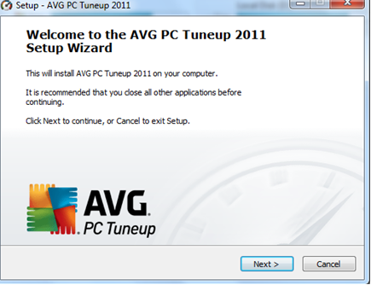
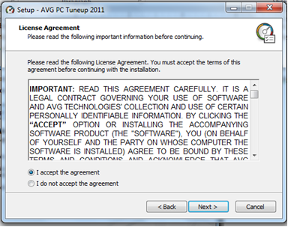

Slide 177
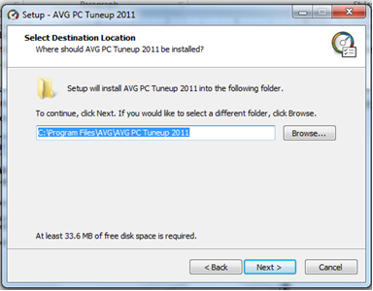

Slide 178
Remember the following before and when installing a program
To read the manuals for the program or the readme file located in the same directory as the install commonly contain exact instructions on how to install a program.
To make sure your computer meets the requirements of the program, game, or utility you are attempting to install.
After installing or during the installation, a program may need to install other programs, files, or utilities before it is able to run. If this is the case, the program will commonly prompt you to install the program or you may need to run a separate installation before the program can be fully used.

Slide 179
When installing a program, utility, or game, it is always a good idea first to close or disable any other programs that are running.
It usually requires the computer system to restart after installing a new program for it to work well, the computer may prompt you to reboot the system for the installed program to work.

Slide 180
Installing Device drivers
The device driver is a program that controls a particular type of device that is attached to a computer system. Modern operating systems are designed with many device drivers. The operating system will automatically detect any new hardware attached to it and install an appropriate driver and it will be able to work. However, if you buy a new type of device that the operating system whose driver was not included in the operating system, you'll have to manually install the new device driver.

Slide 181
Steps to follow In order to Install a new device
Open Windows Device Manager (Start>control panel> systems> hardware tab> device manager. In the Windows 7 Control Panel, Device Manager is under the System group. You can also right-click “My Computer”, then click "Manage" and then click on "Device Driver."). In the Device Manager make sure the device you're attempting to install is not already listed from past install attempts. If the device is found, highlight it and remove it from Device Manager to prevent any conflicts during the install. Find the device that you want to install a driver for.

Slide 182
You may need to choose "View" and "Show hidden devices" to find it, or it may be represented by a yellow question mark if there is no driver for it yet and the computer doesn't recognize it. The categories may help you find it if Windows knows in general what type of device it is. For example, if you have plugged in a new keyboard and there's a yellow question mark under the "Keyboards" category, then you may need to reinstall the keyboard drivers for it to work.
Once you have verified the Device Manager, reboot the computer.

Slide 183
As the computer is rebooting an “install new hardware” wizard should appear if Windows detects the new hardware. Using this wizard you should be able to point the operating system (Windows) to the folder containing your drivers either on the CD, diskette, or the folder containing the files you downloaded;
Select install for a list or specific location this time and click next. Uncheck "search removable media" and check include this location in search. Click the browse button and go to the directory where you saved your new driver. (If it is on CD simply search removable media and it will find it).

Slide 184
Click next and it will attempt to install the driver. Once done click next and your new driver is install. A reboot might be required for the device to work properly.
If Windows does not detect any new hardware, open Control Panel and double-click the Add hardware (or Add a device) icon to run the hardware detection wizard. During the steps you will have an option to tell Windows whether you have a disk containing the drivers for your new hardware device, at this point direct Windows to the directory containing the drivers for your device.

Slide 185
Once drivers have been installed reboot.
Executable driver files
Many computer and hardware manufacturers today pre-package their drivers into executable files(usually in compressed form) or have the drivers installed through the setup file, which means you only have to double-clicking the setup file to install the drivers to the computer.

Slide 186
Upgrading drivers for already installed devices
It may be necessary to update a device driver for the device to worker better; ensure that the latest device driver for each of the devices is loaded onto the computer system. Manufacturers frequently update their drivers to fix problems of earlier versions and take advantage of upgraded operating system features. These drivers are usually available from the manufacturer's Web site for downloading. In the Hardware Update Wizard, click to select the Have Disk option or any other disk where the downloaded file is located, and then click the Browse button to locate the driver files.

Slide 187
Or
Open Windows Device Manager. In the Device Manager locate the device you wish to update the drivers for.
Right-click the device and click Properties.
In the Properties window click the Driver tab.
Click the Update Driver button.
In the Hardware Update Wizard point Windows to the location of the updated drivers on your hard disk drive

Slide 188
Once drivers have been installed reboot.
Install through the .inf file
The installation instructions for drivers and hardware devices are always contained in an .inf file (has .inf extention) this file is located within the drivers. This is a Setup Information file which is a plain text file used by an operating system for installation of software and drivers, it tells the operating system on how to go about with the installation process. For example, Autorun.inf is the primary instruction file associated with the Autorun function.

Slide 189
Autorun.inf itself is a simple text-based configuration file that tells the operating system which executable file to start, which icon to use, and which additional menu commands to make available.
Locate the .inf for the progam you want to install then right-click that file and choose the option for install. Once you have right-clicked and installed the driver, reboot the computer.

Slide 190
Many software programs, games, and utilities have an AutoPlay feature that will automatically start the setup screen for the software program when the software CD/DVD is placed in the computer. If this is the case, run the installation through the screen that appears after inserting the disk in the CD/DVD ROM drive.
Otherwise you need to open the folder where the setup executable file resides to be able to select and run it.

Slide 191
For example;
Open My Computer.
Within My Computer window, open the drive that contains the installation files. It may be on a CD or DVD, in that case, open the D: drive or the letter of the disk drive.
Within the drive that contains the files, locate either a setup or install file. The setup executable file must have the .exe extension. Double-clicking on this file should start the installation for the program, game, or utility.

Slide 192
The alternative method of starting an installation in Windows is the following;
Click Start then Run. In case of windows 7, find run in accessories
In the Run Window, type x:\setup or x:\install where x is the letter of the drive you wish to start the installation from. For example, if you want to install a program from a CD would type D:\setup or D:\install.if your CD drive is designated with the letter D

Slide 193
In case you fail to install a software program
You may fail to install software for a number of reasons;
The software source CD may not be readable. Verify the disk is readable by reading the files on the drive. For example, Microsoft Windows users can explore the drive in Windows explorer. If the CD attempts to AutoPlay, you may need to right-click the drive and click Explore to browse the drive.

Slide 194
The computer system may not have the system requirements for the software to run, verify that your computer meets the minimum requirements of the software program. If your computer does not have enough disk drive space or does not meet the requirements, the program will not install.
The software may not be compatible with the computer system. Make sure the program or utility you are installing is compatible with the version of operating system you have on your computer.

Slide 195
Most proprietary software requires that a registration code or serial number is entered before the software is entered. If you are getting stopped at the CD-KEY or Serial Number verification, verify you are entering your correct number. If you lost your number or key or it does not work, you will need to contact the developer of the program

Slide 196
Uninstalling software
Software uninstallation is the deliberate process of removing part or all of a given software from the computer. There are several reasons why one may wish to uninstall software from the computer;
The software may not be working properly due to corrupt files, or improper installation, hence the need for a clean reinstallation of the program which requires that the program must be uninstalled first.
It could be that the software is no longer being used and is unnecessarily taking up valuable disk space.

Slide 197
The software may be conflicting with other programs installed on the computer.
The software may not be meeting your expectations, that is, it's not functioning as expected.
You may be running out of disk space, therefore you just want to free up some space on your computer's hard drive.
It is always necessary to carry out a proper uninstallation through proper program uninstall procedure instead of merely deleting the program folder and shortcuts

Slide 198
If you are using windows, get to Programs and Features control panel, then choose uninstall program to properly uninstall the program;
Go to the Control Panel and double-click on the "Add or Remove Programs" icon. Scroll down the list until you find the software you wish to uninstall, then click the program icon and hit the "Remove" button. This should begin the uninstall process.

Slide 199
The uninstaller
An uninstaller, also called a de-installer, is utility software which is designed to remove all or parts of a specific other application software. It is always recommended to use an uninstaller to uninstall a program.
It is recommended to run the disk defragmenter when you have finished uninstalling a program because, removing software leaves gaps in the hard drive where the software files used to be which may slow the system's performance. The defragmenter eliminates these gaps, which helps to improve the computer's performance. The defragmenter can be found in the "System Tools" folder within the "Start" menu.

Slide 200
Factors to consider before acquiring a computer
Cost of the computer
Connectivity
System requirements
Authenticity of hardware and software
The monitor size
User needs
Portability
Multimedia capability
Available software
Harddisk capacity

